Slide 1
Introduction to easyfundraising.org.uk

Slide 2
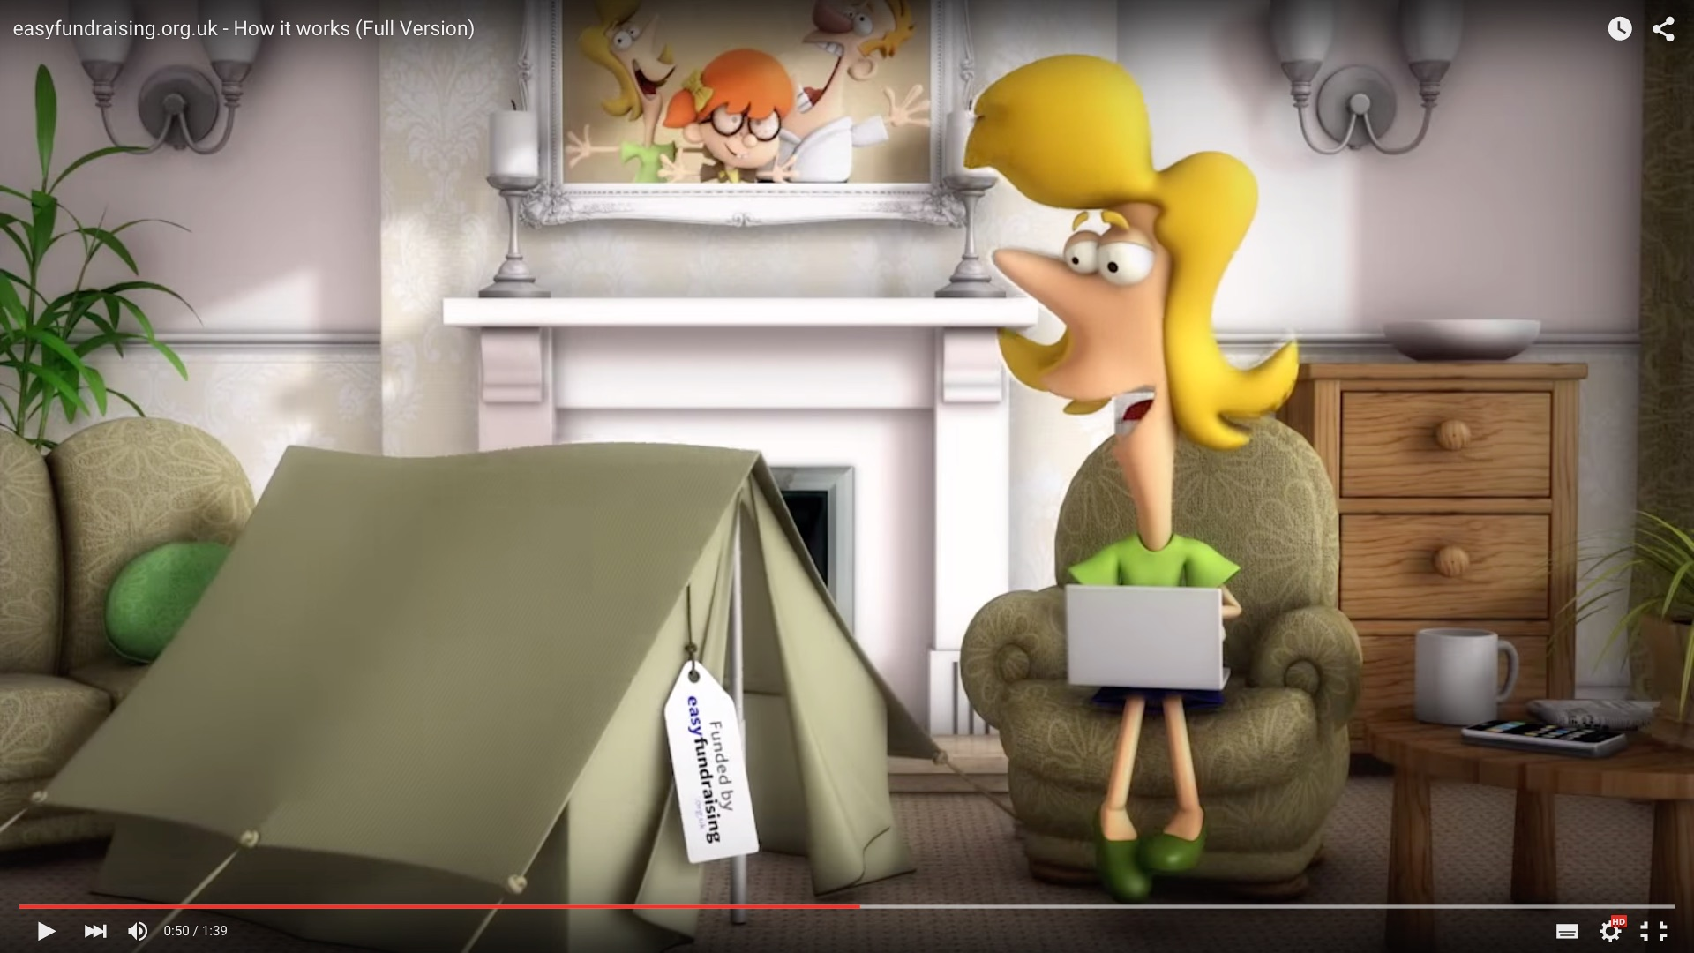
What is easyfundraising?
An easy way to raise FREE funds for [INSERT YOUR UNIT NAME] when you shop online – no cost, no catch
There are almost 3,000 retailers on board, so you can raise on everything from uniforms to utility bills
There are already 65,000 charities and good causes signed up
easyfundraising has raised nearly £10m for good causes around the UK
Over 4,000 units are registered with easyfundraising, raising over £330,000 between them!
Watch the video »

Slide 3
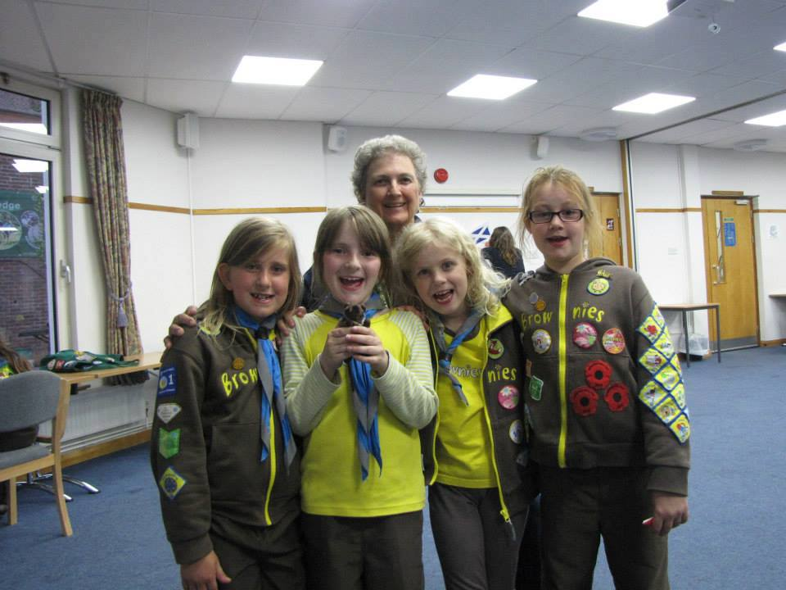
Case Study:
1st Cawston Brownies, Rugby
1st Cawston Brownies have raised over £1,600 which has funded activities and trips which the whole unit community can enjoy!
“‘We loved the professionalism of the site and as it was free to register, we signed up – and we’re very glad we did!’”.
Jen Smith | Unit Leader
Top Tip:
If all the parents of an average sized unit signed up to support, the unit could raise over £190 for the girls this Christmas!

Slide 4
Here’s how it works
1. Start at easyfundraising.org.uk
Every time you shop online, be it a hat or a holiday – head to easyfundraising.org.uk first
2. Make a purchase
Search for the retailer you want and shop as normal. Everything’s the same, including the price
3. Get a donation
When you check out, that retailer will make a donation to our school for no extra cost whatsoever!

Slide 5
Raise on everything
Travel & Days Out
Business Purchases
Fashion & Beauty
School Shopping
Electrical Essentials
Food & Drink

Slide 6
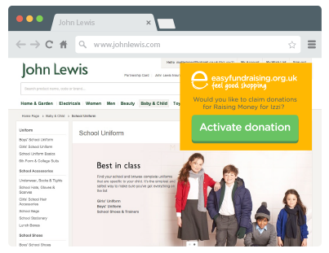
The easyfundraising Donation Reminder
Never miss a free donation with the Donation Reminder. If you think you might forget to shop each time via easyfundraising then the Donation Reminder will help you. It provides a little reminder every time you shop online.
Over 150,000 supporters use it
They raise on average 5x more
It’s free with no annoying ads

Slide 7
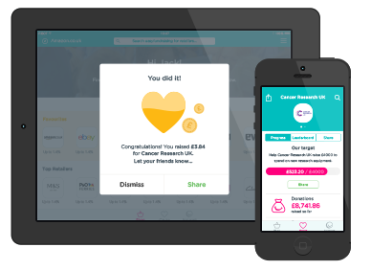
The easyfundraising app
Shop on your mobile or tablet?
Download the free easyfundraising app and make raising donations even easier.
Raise up to 50% more donations
Shop at almost 3,000 retailers on the go
Get notified of your successful donations
Works for iPad, iPhone and iPod touch. (Coming soon for Android!)

Slide 8
5 reasons to sign up now!
It’s easy to raise valuable funds for your unit.
It doesn’t cost you a penny extra when you shop.
The whole unit community can get involved and be making a real difference to the girls’ educational experience.
Join now and you’ll be ready to start raising for Halloween, Bonfire Night and Christmas!
It takes just one units worth of parents to raise £190 this Christmas! *
Register your unit or sign up to support your unit here:
http://ggw.easyfundraising.org.uk
* Based on 30 people raising £6.33
each between Oct-Dec

